Slide 1
Advanced Front-End Programming (CPAN 144)
Week 10
Lecturer: Harshdeep Singh
Summer 2024

Slide 2
Agenda
React API call
Creating UI with 3rd party components
react-bootstrap

Slide 3
Calling APIs in React
In React, components have LifeCycle-Methods that are executed during the different phases of the components.
Lifecycle methods are custom functionality that gets executed during the different phases of a component. There are methods available when the component gets created and inserted into the DOM (mounting), when the component updates, and when the component gets unmounted or removed from the DOM.

Slide 4
Calling APIs in React
To call the API though HTTP request:
Use useEffect with functional components.
Here’s the API we’re going to use for the example:
https://jsonplaceholder.typicode.com/todos/1

Slide 5
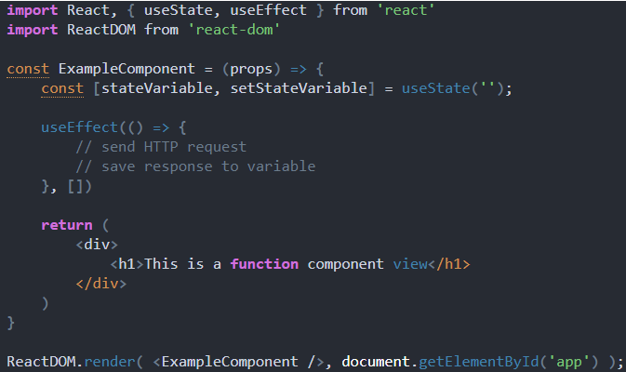
Function component

Slide 6

React-Bootstrap

Slide 7
React Bootstrap
React-Bootstrap replaces the Bootstrap JavaScript.
React-Bootstrap is a complete re-implementation of the Bootstrap components using React.
The best way to consume React-Bootstrap is via the npm package which you can install with npm
npm install react-bootstrap bootstrap@5.1.3
To import bootstrap files, add the following line to the top of App.js
import 'bootstrap/dist/css/bootstrap.min.css';

Slide 8
React-Bootstrap
import * as React from 'react';
import Alert from 'react-bootstrap/Alert';
function Example() {
return (
<Alert dismissible variant="danger">
<Alert.Heading>Oh snap! You got an error!</Alert.Heading>
<p>
Change this and that and try again.
</p>
</Alert>
)
}

Slide 9
React Bootstrap examples
Here are all some examples in github:
https://github.com/react-bootstrap/code-sandbox-examples/blob/master/README.md

Slide 10
Submit your class Activities
Navigate to Course Content -> Assessments -> Labs -> Lab 9 and download the instruction for lab 9.
Once you fulfill all the requirements of the lab, ZIP all your source files and submit them into Course Content -> Assessments -> Labs -> Lab 9
Pay attention to the due date defined on the blackboard submission box for this activity.

